Slide 1
Institute for Integrated Circuits
Project work
Design of a Low-Leakage Low-Power 2-Kbit Custom SRAM for a Medical Implant
Rafiul Islam, 16 August 2021

Slide 2
Outline
Introduction
Leakage reduction technique
- Power gating
- Body biasing
- Reduction of short-channel effect
Inverter characterization
SRAM peripheral circuit
- Multiplexer & decoder
- Sense amplifier
- Write driver
- Control unit
Simulation result
- Verification
- Stand-by current
- SPI interface

Slide 3
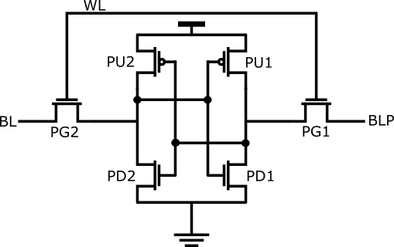
Introduction
A 6T Static Random Access Memory (SRAM) includes two cross-coupled inverters formed by two pull-up transistors (PU), two pull-down transistors (PD) and two pass transistors (PG) for accessing the cell.
Figure 1. A 6T SRAM cell [1] M. Faragalla, et. al, ICCES, 2017

Slide 4
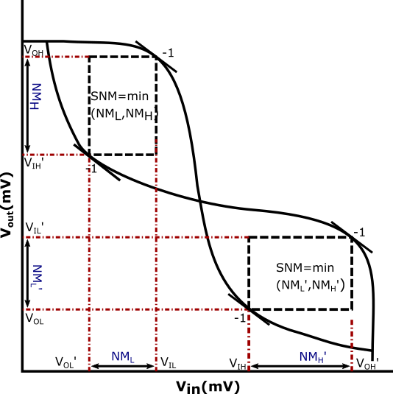
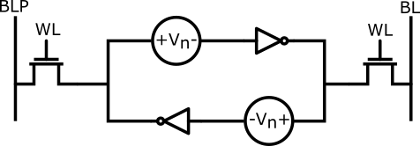
Basic SRAM Design Parameter
Cell Stability.
- Measured by Static Noise Margin (SNM).
Low Leakage Operation.
Memory write speed = 4 MHz.
Memory read speed = 1 MHz.
Figure 2. The standard setup for SNM definition [2] E. Grossar, et. al, IEEE, 2006
Figure 3. Graphical representation of SNM [1] M. Faragalla, et. al, ICCES, 2017

Slide 5
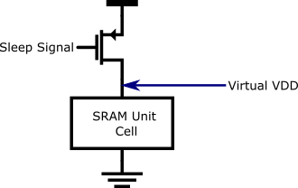
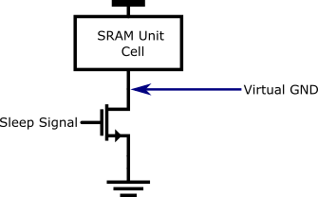
Power Gating Technique
The conventional power gating devices can be classified into two main categories:
- Header and footer devices [7] C.-H. Hua, et. al, MTDT’05, 2005.
By header device, the supply voltage is reduced during sleep mode.
By footer device, the source line is raised which leads to body effect in NMOS.
Multiple-threshold voltage CMOS (MTCMOS) can be additional low leakage technique [3] K. Roy, et. al, IEEE, 2003.
Figure 4. Conventional PMOS header power gating [6] M.-B. Lin, CRC Press, 2012
Figure 5. Conventional NMOS footer power gating [6] M.-B. Lin, CRC Press, 2012

Slide 6
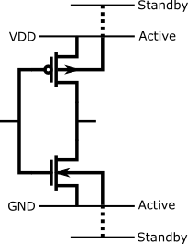
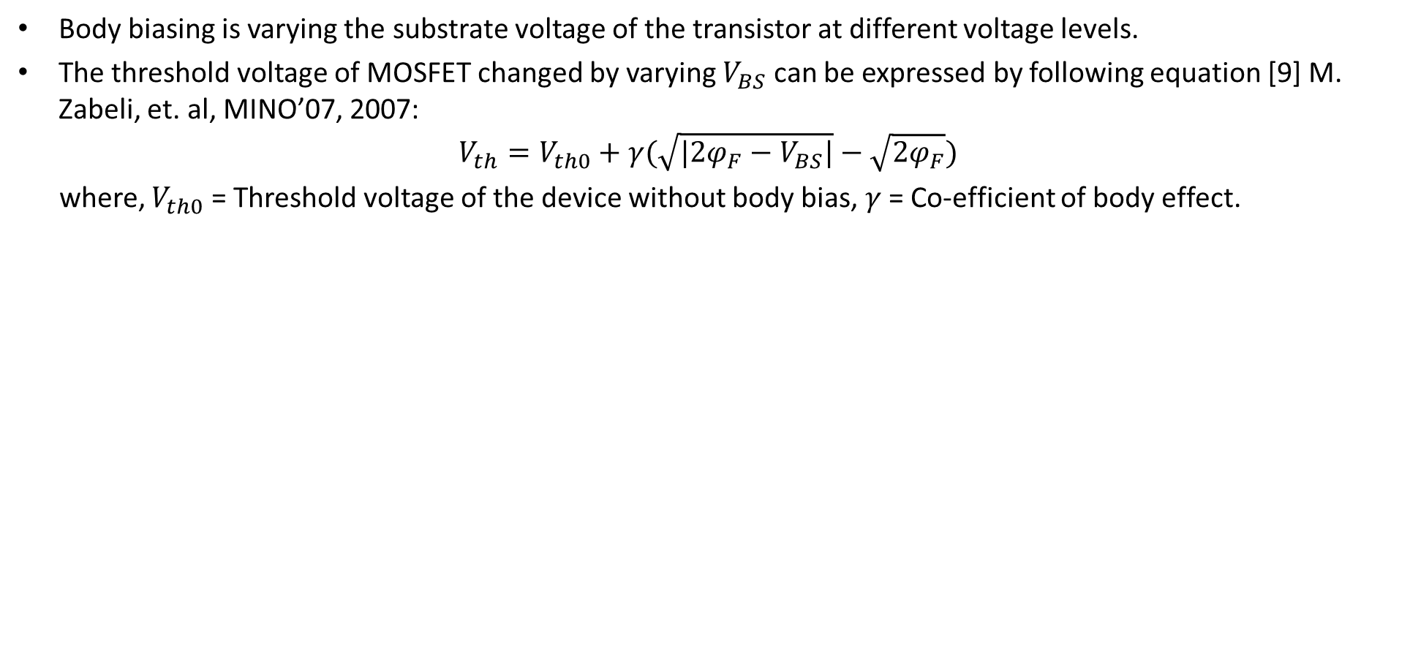
Body Biasing Technique of MOSFET
Body biasing is varying the substrate voltage of the transistor at different voltage levels.
The threshold voltage of MOSFET changed by varying $V_{BS}$ can be expressed by following equation [9] M. Zabeli, et. al, MINO’07, 2007:
$$V_{th}=V_{th0}+γ(\sqrt{|2φ_{F}−V_{BS}|}−\sqrt{{2φ}_{F}})$$
where, $V_{th0}$ = Threshold voltage of the device without body bias, $γ$ = Co-efficient of body effect.
Figure 6. Variable Threshold CMOS (VTCMOS) [3] K. Roy, et. al, IEEE, 2003

Slide 7
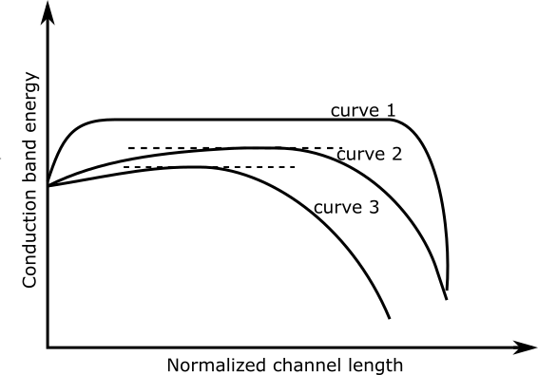
Short Channel Effect
Short channel effect is occurred when MOSFET's threshold voltage decreases due to the reduction in channel length [4] T. H. N. Yuan Taur, et. al, CU Press, 2009.
Curve 1: Long channel potential barrier.
Curve 2: Short channel potential barrier.
Curve 3: Drain Induced Barrier Lowering (DIBL).
Figure 7. Conduction band energy versus lateral distance (normalized to the channel length) [4].

Slide 8
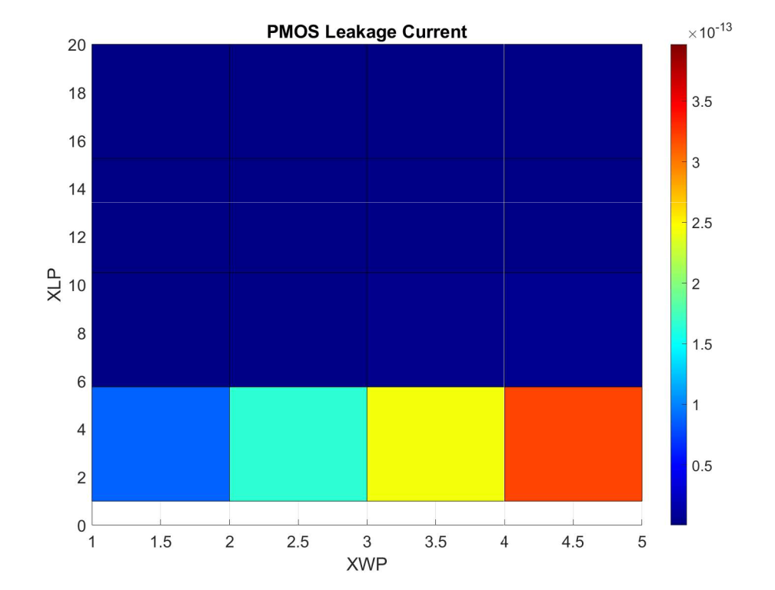
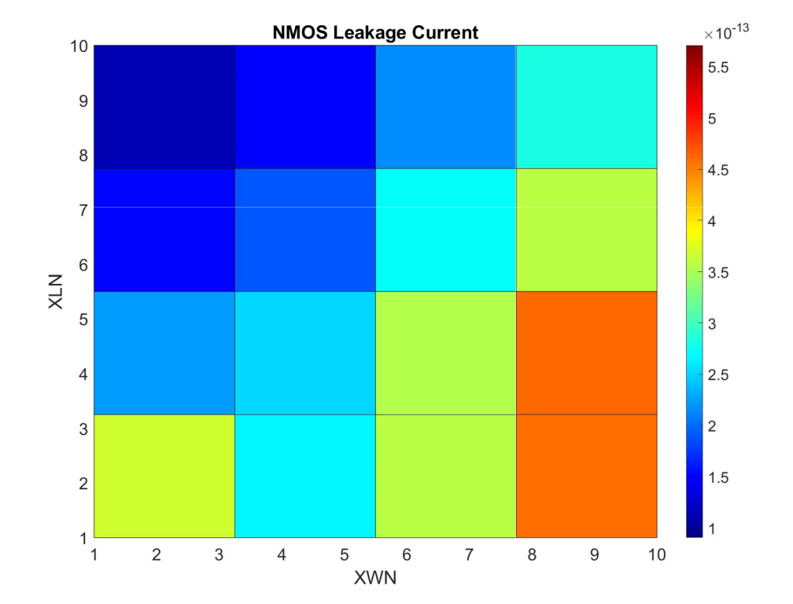
Inverter Characterization
Leakage current is determined over channel length variation.
XWP: PMOS Width Multiplier | XWN: NMOS Width Multiplier
XLP : PMOS Length Multiplier | XLN : NMOS Length Multiplier
(a) PMOS
(b) NMOS
Figure 8. Leakage Current Versus transistor dimension

Slide 9
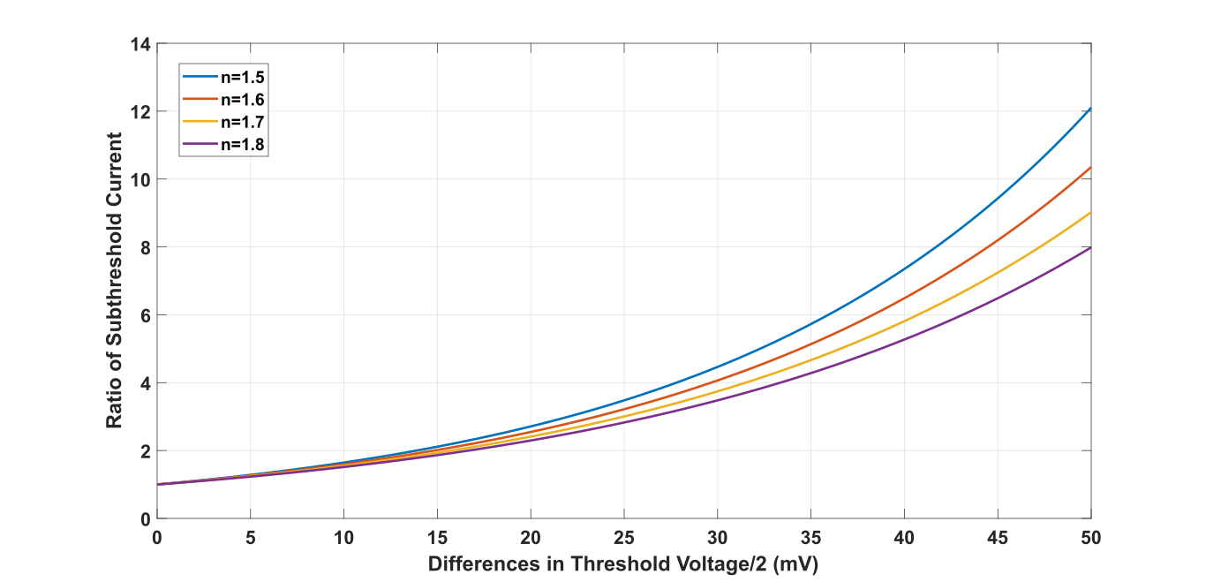
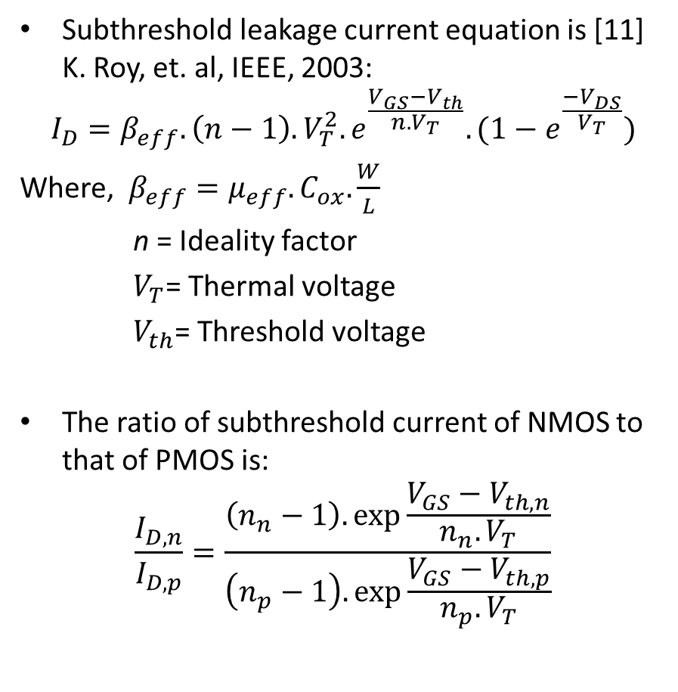
Inverter Characterization
Subthreshold leakage current equation is [11] K. Roy, et. al, IEEE, 2003:
$$I_{D}=β_{eff}.\left(n−1\right).V_{T}^{2}.e^{\frac{V_{GS}−V_{th}}{n.V_{T}}}.(1−e^{\frac{−V_{DS}}{V_{T}}})$$
Where, $β_{eff}=μ_{eff}.C_{ox}.\frac{W}{L}$
n = Ideality factor
$V_{T}$= Thermal voltage
$V_{th}$= Threshold voltage
The ratio of subthreshold current of NMOS to that of PMOS is:
$$\frac{I_{D,n}}{I_{D,p}}=\frac{\left(n_{n}−1\right).\exp{\frac{V_{GS}−V_{th,n}}{n_{n}.V_{T}}}}{\left(n_{p}−1\right).\exp{\frac{V_{GS}−V_{th,p}}{n_{p}.V_{T}}}}$$
Figure 9. Difference in Subthreshold Current
Assuming both transistors have same $β_{eff}$ and terminal voltages $\left|V_{GS}\right|$ and $\left|V_{DS}\right|$

Slide 10
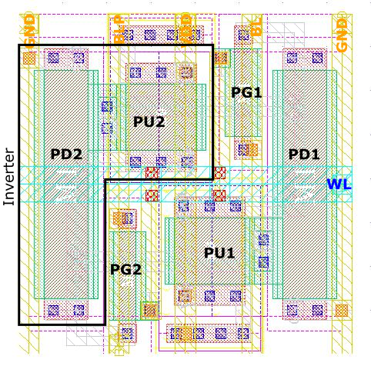
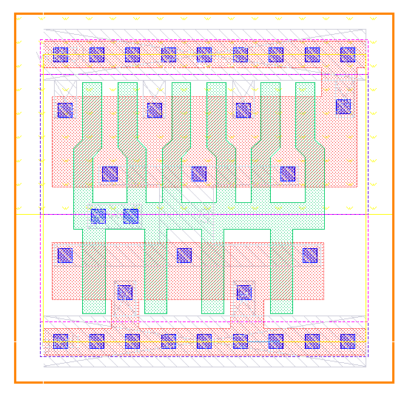
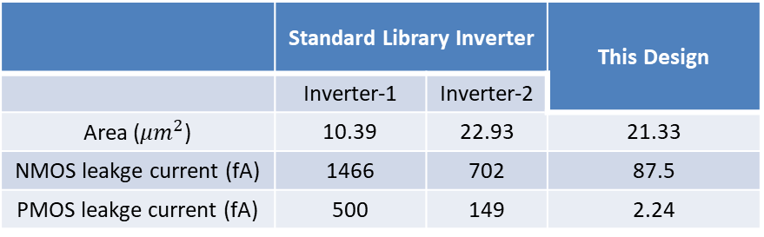
Difference in Leakage Current
Table 1. Difference in leakage current
 | Standard Library Inverter |  | This Design
 | Inverter-1 | Inverter-2
Area ($μm^{2}$) | 10.39 | 22.93 | 21.33
NMOS leakge current (fA) | 1466 | 702 | 87.5
PMOS leakge current (fA) | 500 | 149 | 2.24
Figure 10. SRAM unit cell layout
Figure 11. Inverter from standard library (180 nm XFAB Tech)

Slide 11
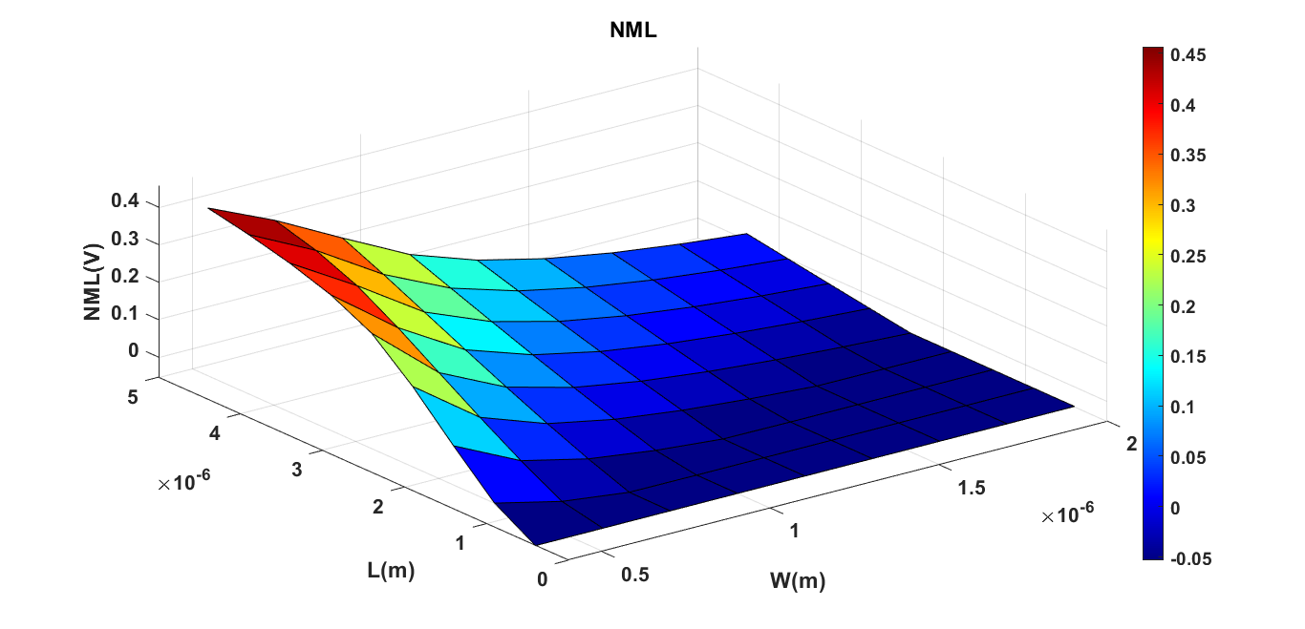
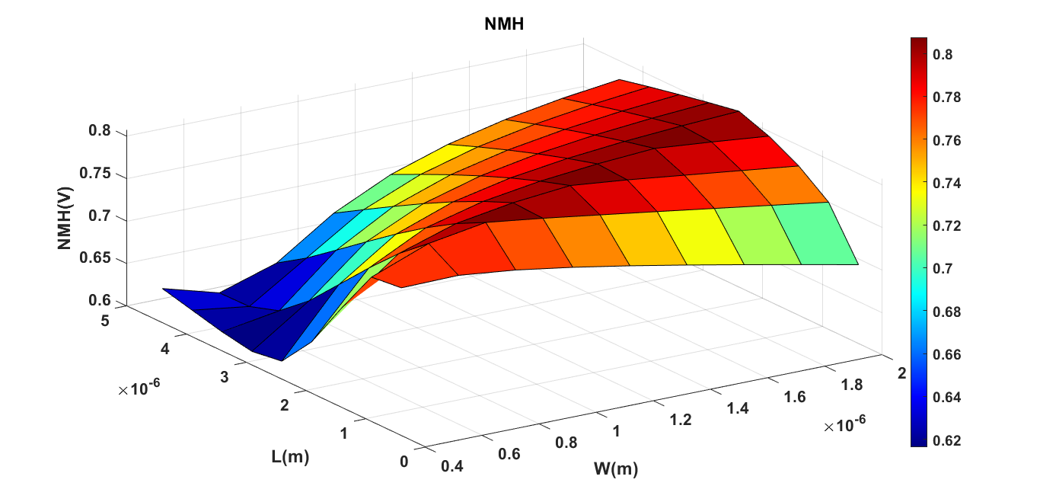
Cell Stability
the SNM of the SRAM cell depends on the relative strengths of the transistors: PD> PG > PU [6] M.-B. Lin, CRC Press, 2012 .
Figure 1. A 6T SRAM cell
Figure 12. NML versus access transistor dimension
Figure 13. NMH versus access transistor dimension

Slide 12
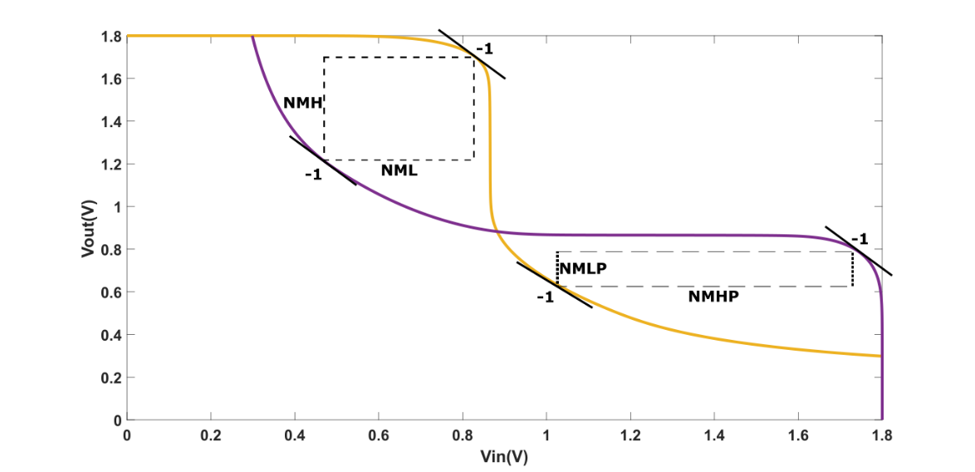
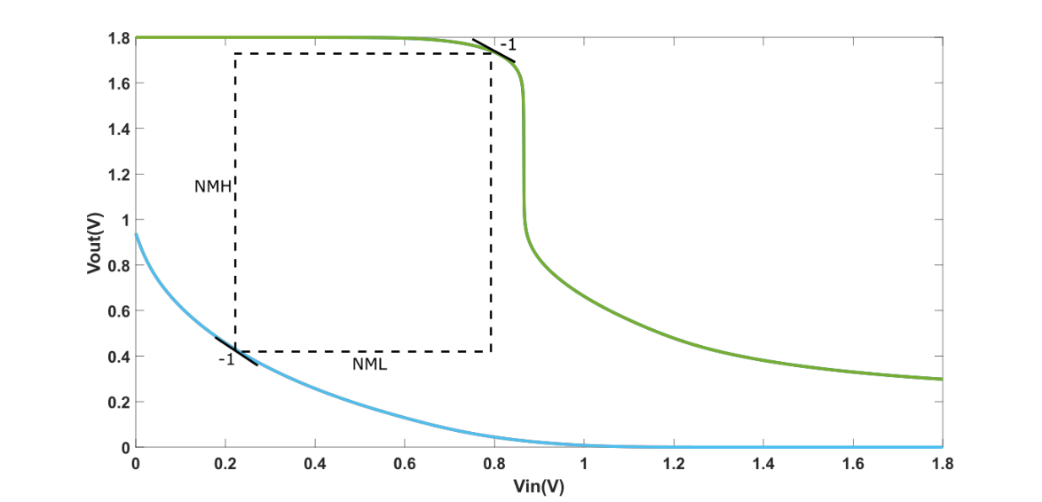
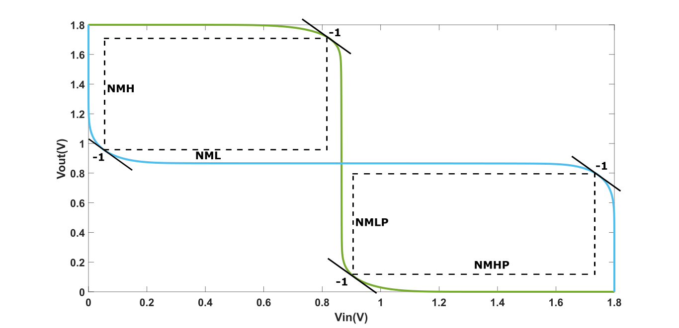
Static Noise Margin (SNM)
Table 2. Numerical Static Noise Margin (SNM)
 | Static Noise Margin (SNM)
 | Write Stability | Read Stability
NML | 502.9 mV | 246.3 mV
NMH | 1.375 V | 650.3 mV
NMLP |  | 246.3 mV
NMHP |  | 650.3 mV
(a) Read SNM
(b) Write SNM
(c) Hold SNM
Figure 14. Static Noise Margin (SNM)

Slide 13
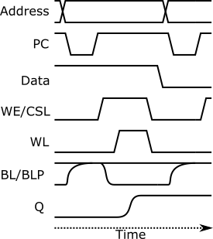
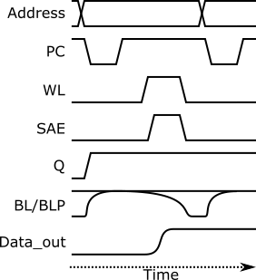
Basic Write & Read Operation
(a) Write
(b) Read
Figure 15. Conceptual Timing Diagram [4] T. H. N. Yuan Taur, et. al, CU Press, 2009

Slide 14
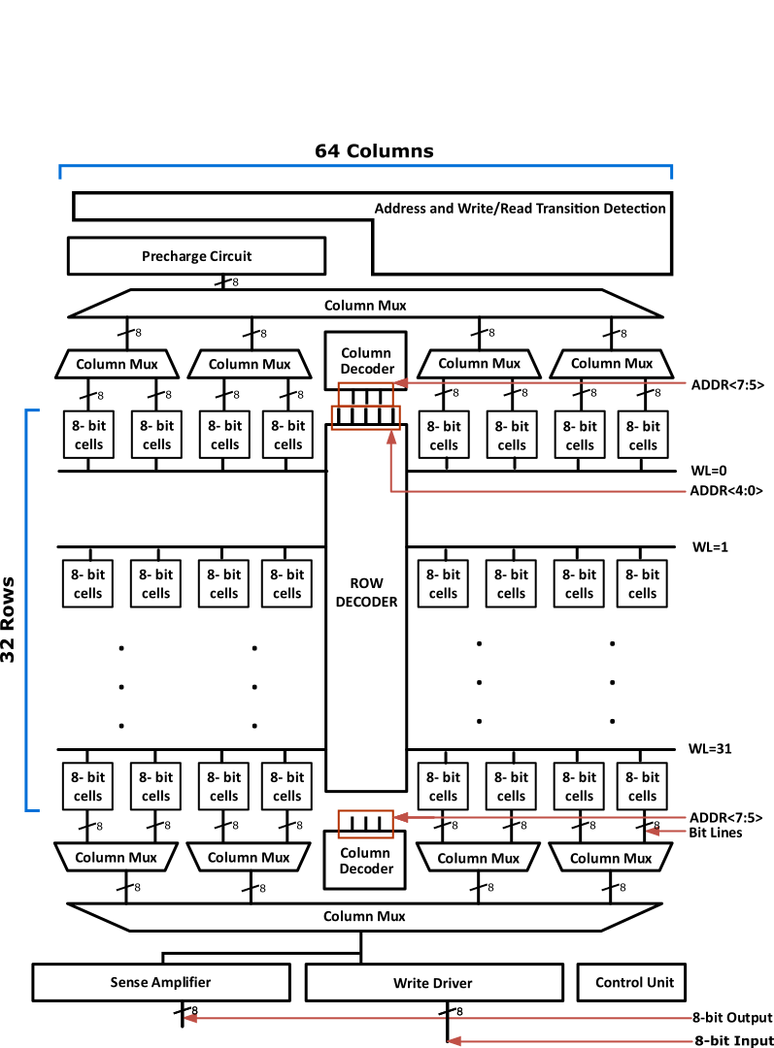
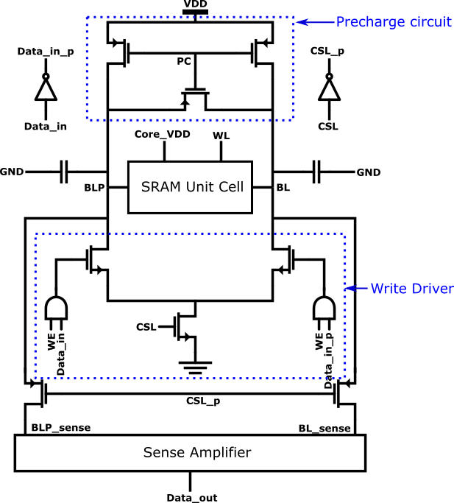
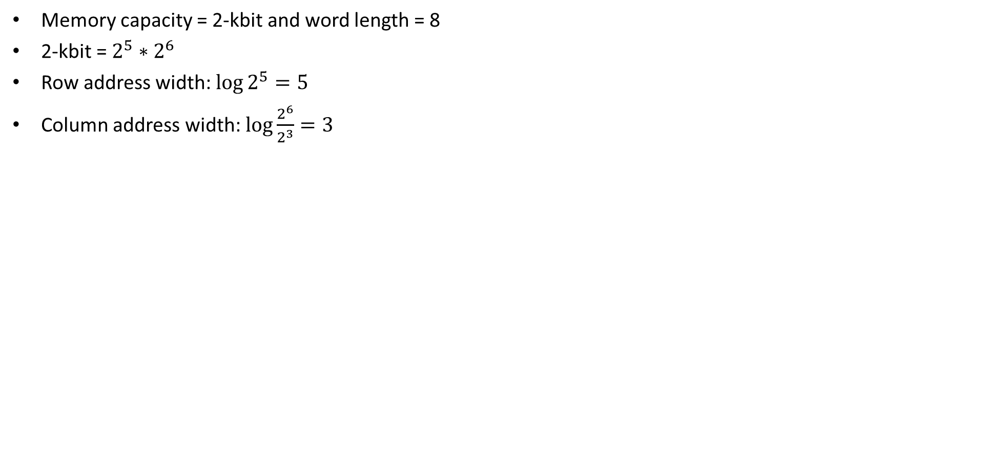
SRAM System
Memory capacity = 2-kbit and word length = 8
2-kbit = $2^{5}∗2^{6}$
Row address width: $\log{2^{5}=5}$
Column address width: $\log{\frac{2^{6}}{2^{3}}}=3$
Figure 16. SRAM unit cell with peripheral circuit
Figure 17. Full SRAM with peripheral circuit

Slide 15
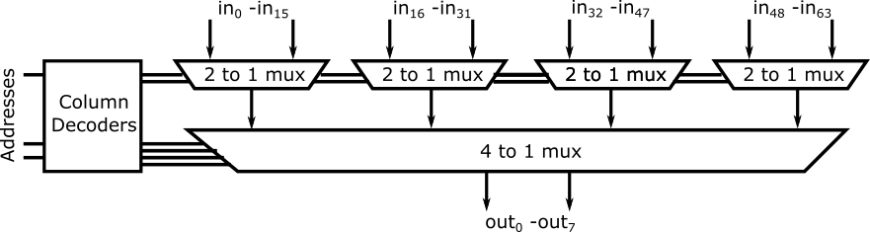
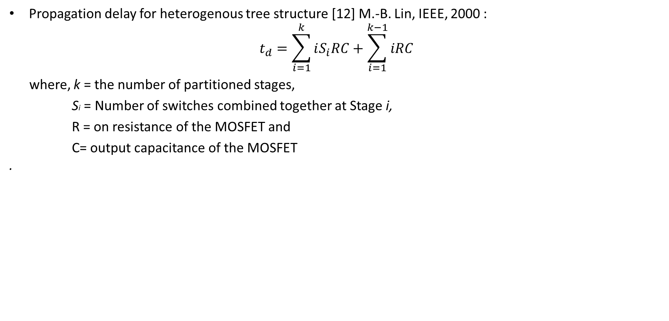
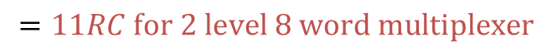
Column Multiplexer
Propagation delay for heterogenous tree structure [12] M.-B. Lin, IEEE, 2000 :
$$t_{d}=\sum_{i=1}^{k}{iS_{i}RC+\sum_{i=1}^{k−1}{iRC}}$$
where, k = the number of partitioned stages,
Si = Number of switches combined together at Stage i,
R = on resistance of the MOSFET and
C= output capacitance of the MOSFET .
There are different column multiplexer structures [6] M.-B. Lin, CRC Press, 2012
Among them
- Heterogenous tree structure multiplexer
- Binary tree structure multiplexer
are mostly used structures.
$$=11RC for 2 level 8 word multiplexer$$
Figure 18. Block diagram of heterogeneous tree structure column multiplexer

Slide 16
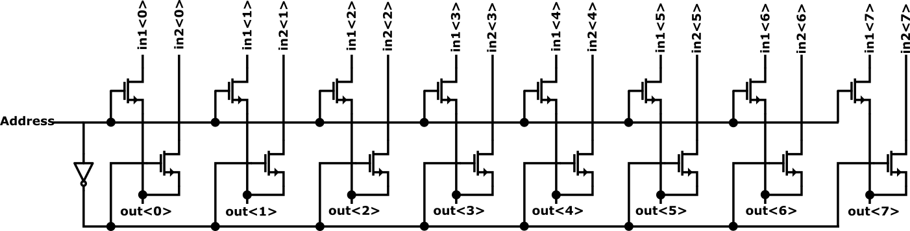
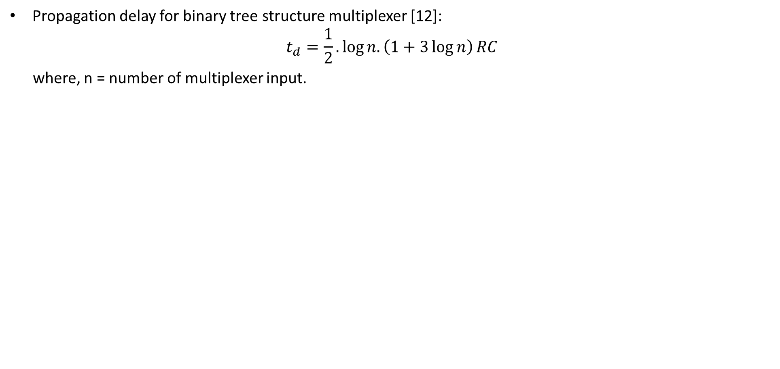
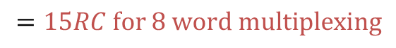
Column Multiplexer
Propagation delay for binary tree structure multiplexer [12]:
$$t_{d}=\frac{1}{2}.\log{n.\left(1+3\log{n}\right)}RC$$
where, n = number of multiplexer input.
$$=15RC for 8 word multiplexing$$
Figure 19. Circuit diagram of 2:1 word multiplexer

Slide 17
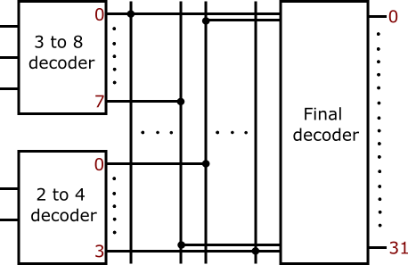
Row Decoder
Multilevel row decoder has been used for 32 rows.
Figure 20. Row Decoder

Slide 18
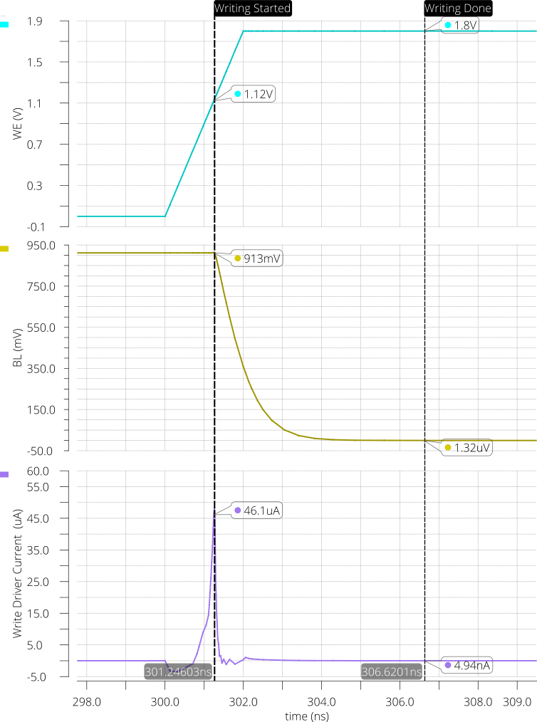
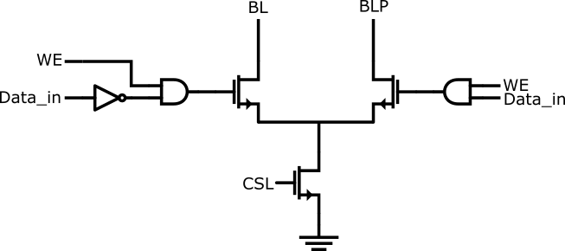
Write Driver
Writing operation is done by discharging one of the bit- lines.
Figure 21. Write driver circuit [6] M.-B. Lin, CRC Press, 2012
Figure 22. Waveform for the write driver

Slide 19
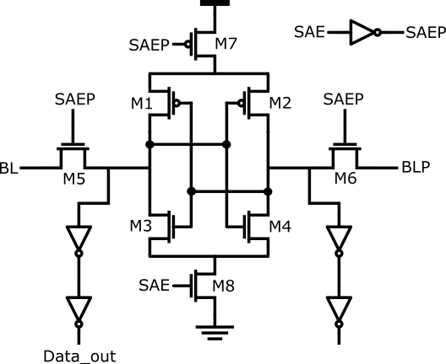
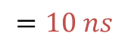
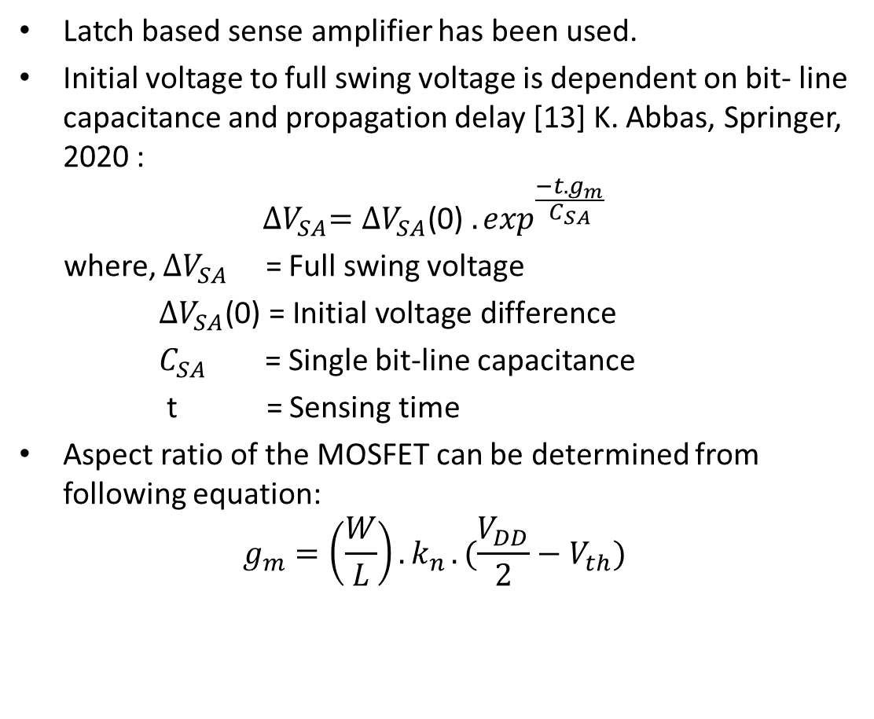
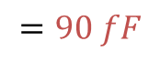
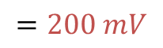
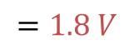
Sense Amplifier
Latch based sense amplifier has been used.
Initial voltage to full swing voltage is dependent on bit- line capacitance and propagation delay [13] K. Abbas, Springer, 2020 :
$${∆V}_{SA}={∆V}_{SA}\text{(0)} {.exp}^{\frac{−t.g_{m}}{C_{SA}}}$$
where, ${∆V}_{SA}$ = Full swing voltage
${∆V}_{SA}\text{(0)}\text{ = }\text{Initial} \text{voltage} \text{difference}$
$C_{SA}$ = Single bit-line capacitance
t = Sensing time
Aspect ratio of the MOSFET can be determined from following equation:
$$g_{m}=\left(\frac{W}{L}\right){.k}_{n}.(\frac{V_{DD}}{2}−V_{th})$$
$$=1.8 V$$
$$=200 mV$$
$$=90 fF$$
$$=10 ns$$
Figure 23. Circuit diagram of sense amplifier [6] M.-B. Lin, CRC Press, 2012

Slide 20
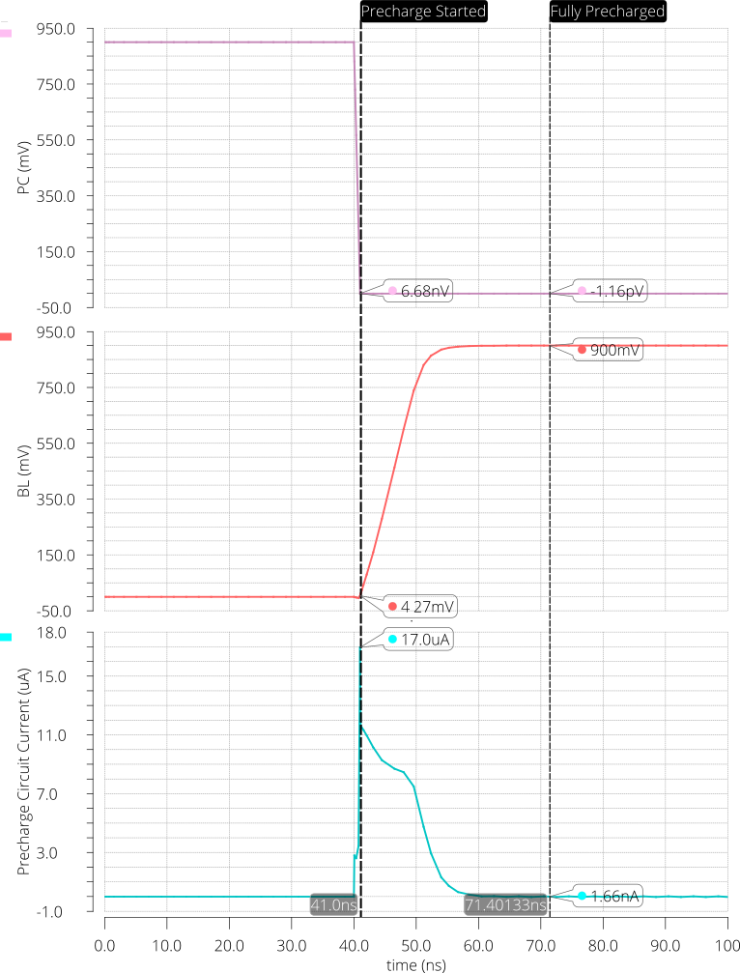
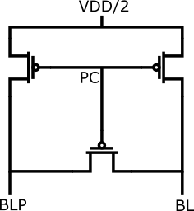
Precharge Circuit
8 precharge circuit have been used to precharge the bit-lines.
Precharge voltage is VDD/2.
Figure 24. Precharge circuit [6] M.-B. Lin, CRC Press, 2012
Figure 25. Waveform for the precharge circuit

Slide 21
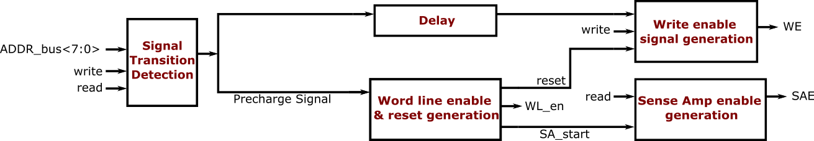
Control Unit
‘Signal transition detection’ circuit generates a ‘Precharge Signal’.
‘Precharge Signal’ is used as a clock for the other sub-circuit in the control unit.
Either ‘Write enable signal generation’ or ‘sense Amp enable generation’ circuit will be activated depending on ‘write’ or ‘read’ command respectively.
Figure 26. Control Unit Block Diagram

Slide 22
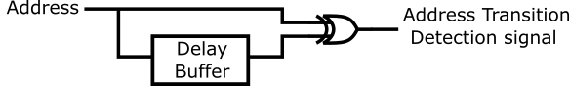
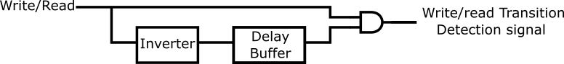
Signal Transition Detection
‘Signal Transition Detection’ circuit consists of ‘Address Transition Detection’ and ‘write/read transition detection circuit’.
‘write/read transition detection circuit’ only detects positive signal transition.
Figure 27. Address transition detection circuit
Figure 28. write/read transition detection circuit
Figure 29. Signal transition detection circuit [6] M.-B. Lin, CRC Press, 2012

Slide 23
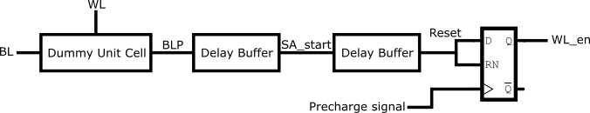
Control Unit Cont...
Dummy unit cell is used to get the discharging period of the bit line capacitance.
‘Reset’ signal is used reset both ‘WL’ and ‘WE’.
Figure 30. Word line enable and reset signal generation circuit

Slide 24
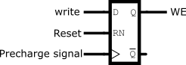
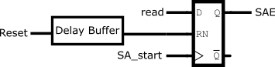
Control Unit Cont...
SR flip-flop has been used for both ‘Write enable signal generation circuit’ and ‘Sense amplifier enable signal generation circuit’.
Figure 31. Write enable signal generation circuit
Figure 32. Sense amplifier enable signal generation circuit

Slide 25
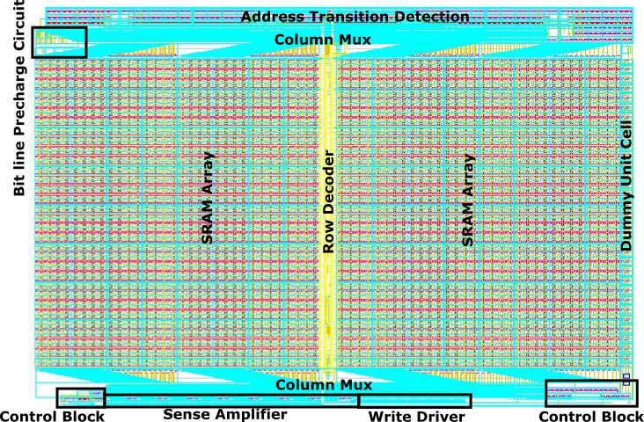
SRAM Layout
Total Dimension: 500 µm X 355 µm
Figure 33. Full SRAM Layout

Slide 26
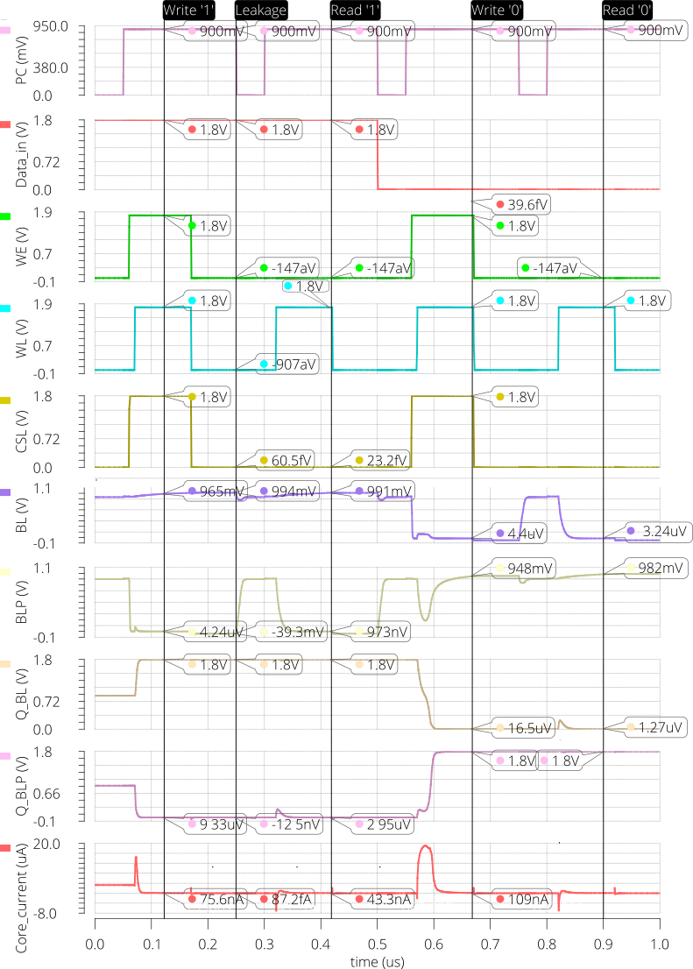
Unit Cell Simulation
Figure 34. SRAM unit cell with peripherals
Figure 35. Waveform of the verification of the SRAM

Slide 27


Control Unit Verification
Figure 36. Test-bench for the control unit
Figure 37. Waveform of the control unit

Slide 28

Stand-by Current
Stand-by current is approximately 231 pA.
The read cycle consumes almost 500 µW averaged over 1 µs and the write cycle consumes almost 650 µW averaged over 250 ns.
Figure 38. SRAM core stand-by current

Slide 29

SRAM Verification
Table 3. Data for the verification of the SRAM
Time (μs) | 0 | 0.25 | 0.5 | 0.75 | 1 | 1.25 | 1.5 | 1.75 | 2 | 2.25 | 2.5 | 2.75 | 3 | 3.25 | 3.5 | 3.75 | 4 | 4.25 | 4.5 | 4.75 | 5
Command | W | W | R | W | R | W | R | W | R | W | R | W | R | W | R | W | R | W | R | W | R
Data_in<0> | 0 |  |  |  | 1 |  |  |  | 0 |  |  |  | 1 |  |  |  | 0 |  |  |  | 1
Data_in<7> | 1 |  |  |  | 0 |  |  |  | 1 |  |  |  | 0 |  |  |  | 1 |  |  |  | 0
ADDR<7:0> | 20 | 00 | 20 | 20 | 00 | C0 | A0 | BF | C0 | 1F | BF | 3F | 1F | 20 | 3F | 00 | 20 | 32 | 00 | 12 | 32
Expected Output
Data_out<0> |  |  | 0 |  | 0 |  | 0 |  | 1 |  | 1 |  | 0 |  | 0 |  | 1 |  | 1 |  | 0
Data_out<7> |  |  | 1 |  | 1 |  | 1 |  | 0 |  | 0 |  | 1 |  | 1 |  | 0 |  | 0 |  | 1
Figure 39. Waveform of the verification of the SRAM

Slide 30

Serial Peripheral Interface (SPI)
SPI has 4 channels:
- MOSI (Master Output Slave Input) : Channel for the master to send data to the slave.
- MISO (Master Input Slave Output) : Channel for the master to receive data from the slave.
- clk : Channel for the clock signal.
- CSEL (Chip Select) : Channel for the master to select slave.
Figure 40. SPI concept

Slide 31


SPI Interface
Figure 41. Operation of MOSI in SPI
Figure 42. Operation of MISO in SPI

Slide 32


SRAM with SPI Interface
(a) Normal view
(b) Expanded view
Figure 43. SPI waveform for SRAM

Slide 33
Institute for Integrated Circuits
Thank you for your attention!
Questions?
Rafiul Islam

Slide 34
References
[1] M. R. Faragalla, M. A. Ewais, H. F. Ragai, M. S. Badran, and H. H. Issa, “Impact of process variability on FinFET 6T SRAM cells for physical unclonable functions (pufs),” in 2017 12th International Conference on Computer Engineering and Systems(ICCES), 2017, pp. 31–36. [2] E. Grossar, M. Stucchi, K. Maex, and W. Dehaene, “Read stability and write-ability analysis of SRAM cells for nanometer technologies,” IEEE Journal of Solid-State Circuits, vol. 41, no. 11, pp. 2577–2588, 2006. [3] K. Roy, S. Mukhopadhyay, and H. Mahmoodi-Meimand, “Leakage current mechanisms and leakage reduction techniques in deep-submicrometer CMOS circuits,” Proceedings of the IEEE, vol. 91, no. 2, pp. 305–327, 2003. [4] T. H. N. Yuan Taur, Fundamentals of Modern VLSI Devies. Cambridge University Press, 2009. [5] V. L. Sangeeta Singh, “Read and write stability of 6T SRAM,” International Journal of Advanced Research in Electronics and Communication Engineering (IJARECE), vol. 3, 2014. [6] M.-B. Lin, Introduction to VLSI Systems. CRC Press, 2012. [7] C.-H. Hua, T.-S. Cheng, and W. Hwang, “Distributed data-retention power gating techniques for column and row co-controlled embedded SRAM,” in 2005 IEEE International Workshop on Memory Technology, Design, and Testing (MTDT’05), 2005, pp. 129–134.
[8] K.-S. Min, K. Kanda, and T. Sakurai, “Row-by-row dynamic source-line voltage control (RRDSV) scheme for two orders of magnitude leakage current reduction of sub-1-V-V/sub DD/ SRAM’s,” in Proceedings of the 2003 International Symposium on Low Power Electronics and Design, 2003. ISLPED ’03., 2003, pp. 66–71.

Slide 35
References
[9] M. Zabeli, N. Caka, M. Limani, and Q. Kabashi, “The impact of MOSFET’s physical parameters on its threshold voltage,” in Proceedings of the 6th Conference on Microelectronics, Nanoelectronics, Optoelectronics, ser. MINO’07. Stevens Point, Wisconsin, USA: World Scientific and Engineering Academy and Society (WSEAS), 2007, p. 54–58. [10] C. Duari and S. Birla, “Low leakage SRAM cell with improved stability for IoT applications,” Procedia Computer Science, vol. 171, pp. 1469–1478, 2020, third International Conference on Computing and Network Communications (CoCoNet’19). [Online]. Available: https://www.sciencedirect.com/science/article/pii/S1877050920311364 [11] K. Roy, S. Mukhopadhyay, and H. Mahmoodi-Meimand, “Leakage current mechanisms and leakage reduction techniques in deep-submicrometer CMOS circuits,”Proceedings of the IEEE, vol. 91, no. 2, pp. 305–327, 2003. [12] M.-B. Lin, “On the design of fast large fan-in CMOS multiplexers,” IEEE Transactions on Computer-Aided Design of Integrated Circuits and Systems, vol. 19, no. 8, pp. 963–967, 2000. [13] K. Abbas, Handbook of Digital CMOS Technology, Circuits, and Systems. Springer,2020. [14] A. Karandikar and K. Parhi, “Low power SRAM design using hierarchical divided bit-line approach,” in Proceedings International Conference on Computer Design. VLSI in Computers and Processors (Cat. No.98CB36273), 1998, pp. 82–88.

